Slide 1

CLIMATE CHANGE PREDICTIONAND TEMPERATURE DETETCION
Tagore Engineering College-Chennai-600127
DR.B.JAISHANTHI
V.SRIVATSAN(412718104019)
Assistant professor
M.RAGHAVENDRAN(412718104015)
M.E,P.H.D
DEEPAK.S(412718104003)
Tagore Engineering college
Chennai-600127

Slide 2
ABSTRACT
Temperature changes in last few years have been increasing tremendously and it is expected to increase more in the future.
Therefore, it is a tedious process to analyse larger forms of climate, temperature changes in the data and perform predictive analysis of the same using traditional methods.
Our project aims to forecast temperature and seasonality changes using predictive analysis with the help of various machine learning techniques such as Linear Regression, Time series forecasting using ARIMA & SARIMAX, Auto-Correlation.
The proposed system serves as a tool which takes in the changes in temperature from large amount of data as input and predicts the future temperature with min, max, and average temperature in an efficient manner and approximately produces the output.
We will be predicting the temperature change from 1992-2024 with the detailed forecast and changes from 2020-2024 and predicting the accuracy in the changes.

Slide 3
INTRODUCTION
Climate change is a crucial challenge in the recent era. It affects many factors of the environmental ecosystems such as, soil erosion, bio-diversity, and changes in sea-water level .
Weather forecasting mitigates the economic crisis and promotes better public health to maintain the quality of life.
Safety and well-being of human is highly implacable by weather changes.
It is also useful in the agricultural domain as it is an essential part of planning the farming operations.

Slide 4
Farmers can make optimal decisions for crops using prediction of weather whether to undertake or withhold the sowing operation.
The consequences of unseasonal changes in weather and their potential negative effects on host plants and pests are very well known.
Unseasonably high temperatures may lead to lower plant productivity and more pests on farm.
Industries such as energy consumption and food security can also benefit from weather forecasting.
As the key problem of weather forecasting, air temperature prediction has manifold benefits for the environment, industry and agriculture
Temperature forecasting is useful in understanding the probability of storm, wildfires, drought and flood occurrence in an area.

Slide 5
EXISITNG SYSTEM
In exisitng system, to automatically discover predictive models for climate change in different horizons i.e. between 1 hour and 24 hours.
The platform evaluated hundreds of thousands models during the discovery process.
While performing the change in climate change we will be evaluating it in hourly basis and we will find the approximate results in change in climate.
The top performing model was selected on the validation dataset and not on the training dataset.
This ensures that the performance of our models indicates how well the models have captured the true underlying structure of the problem.

Slide 6
We present the results for 1 and 24hours forward prediction.
The forecasting accuracy gradually gets reduced while forecasting time increases.
For each forecasting horizon and each target variable of interest, a separate model was discovered as the predictors and the parameters of the model are expected to vary.
In the case of climate predictions, statistical models tend to perform well on short term horizons.
There is a point at which the performance of a physical model exceeds the performance of statistical models.

Slide 7
DISADVANTAGE OF EXISITNG SYSTEM
The main disadvantage of a national climate monitoring system is the cost.
Not just the capital required to purchase, install and/or operate all the necessary equipment, but also the ongoing costs of maintaining the equipment and ensuring accurate collecting of data, building and maintaining databases, making sure that that data is correctly interpreted and, ultimately, ensuring that relevant information is communicated to the appropriate people in a timely fashion.
The quality of the information produced by a climate monitoring system is only as good as the quality of the data collected.

Slide 8
PROPOSED SYSTEM
The main objective of this study is to analyse temperature and seasonality change in Chennai (temperature and seasonality changes like winter, spring, summer) for approx. 10-20 years on the basis data recorded at different place across tamil-nadu and we predict the temperature changes from 2020-2024.Camparing to existing work we can predict the temperature change more accurately.
The specific objectives are:
1) To predict the temperature and seasonality changes for next 10 years.
2) To make a graphical interface based on the prediction to make it easy understand. Machine Algorithms:

Slide 9
There are so many technologies to predict data like svm, linear regression, lasso, elastic net, light gm regressor, Auto Regressive Model, Time series analysis using arima and sarimax etc.
We have tried many of the algorithm to get the highest accuracy.
Data Collection:
In this module the raw is collected data from different data set. Then the data set is changed as per need.
This raw data cannot be predicted directly. So, it is needed to clean and pre-process.
Data Pre-processing :
In this module the data is cleaned. After cleaning of the data, the data is grouped as per requirement.
Visualization:
In this step, the predicted and forecasted data is used to provide a graphical interface separately. At first the predicted data is plotted in a graph separately with the help of matplot library.

Slide 10
ADVANTAGES OF PROPOSED SYSTEM
Extreme precipitation forecasting can be done with climate models and machine learning techniques.
using climate models to predict future concentrations of greenhouse gases.
Machine learning techniques are used in climate model predictions so that they can be run faster and more efficiently.
We are using machine learning algorithms and satellite data such as high-resolution images from the Landsat series of satellites in order to automate this process.
Crop yield forecasting uses machine learning and artificial intelligence techniques to predict climate change impacts such as how changes in rainfall, temperature, etc., will affect a region’s agriculture.
The data used is based on historical climatic conditions along with projections of future climate scenarios.
Machine learning algorithms can be used to predict climate change impacts on crop yields.

Slide 11
It is important for us to be able to predict how climate change will affect sea ice loss in both the Arctic and Antarctic.
Improving estimates of carbon emissions
Carbon dioxide (CO₂) is a heat-trapping greenhouse gas (GHG) that is emitted into the atmosphere through human activities such as driving cars, burning coal or natural gas for energy, and deforestation.
We have developed a climate-carbon cycle model using machine learning algorithms to improve estimates of carbon emissions by 50 percent over traditional methods.
Climate change-induced drought is a major cause of concern. Drought can lead to climate change refugees and also impact agriculture production leading to famines.
There is an urgent need of detecting climate change-induced drought so that appropriate measures are taken up right away in areas, which may be affected soon by climate-induced droughts.

Slide 12
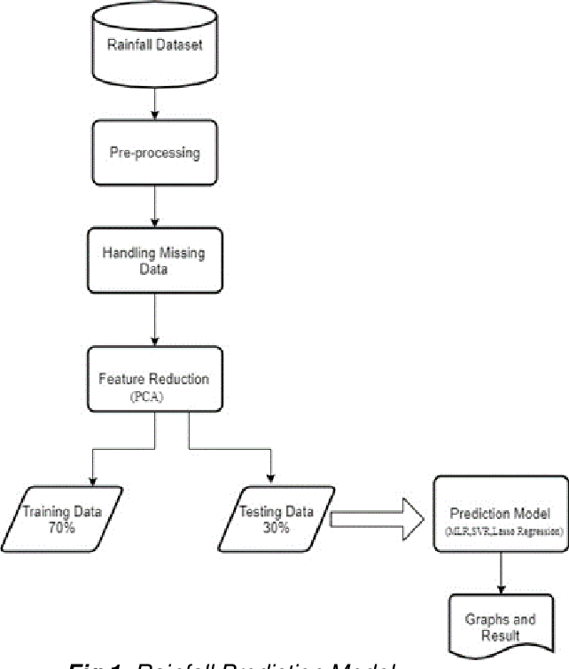
BLOCK DIAGRAM

Slide 13
MACHINE LEARNING MODEL
LINEAR REGRESSION

